Slide 1

Storyteller: Visualizing Natural Language Text
Maarten van Meersbergen

Slide 2
Event data
{ "timeline":
"events": [{
"actors": {
"actor:": [
"dbp:European_Union",
"dbp:United_Kingdom",
"dbp:The_Times",
"dbp:Government_of_the_United_Kingdom"
]
},
"prefLabel": ["stop"],
"time": "20140622",
"climax": 89,
"event": "ev194",
"groupName": "[Community sanction]",
"groupScore": "099",
"labels": [
"stop",
"difficulty",
"pressure"
],
"mentions": [{
"char": [
"5665",
"5673"
],
"perspective": [{
"source": "author:FT_reporters"
}],
"snippet": [" Sunday Times, said they were
extremely concerned about the UK's
difficulties in stopping the EU from
introducing measures that continue to
erode Britain's competitiveness"],
"snippet_char": [ 81, 89 ],
"uri": ["http://www.ft.com/thing/f2bc1380-fa32
-11e3-a328-00144feab7de"]
}, {
(...)

Slide 3
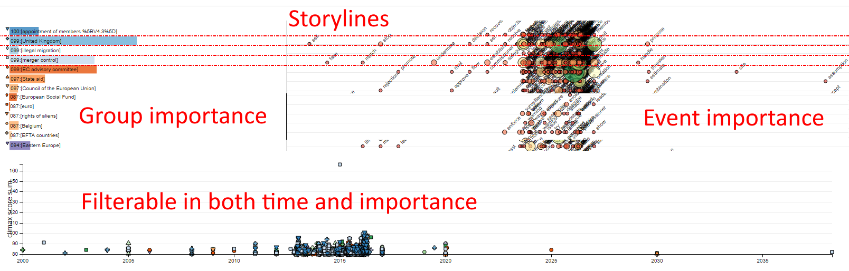
Storylines

Slide 4
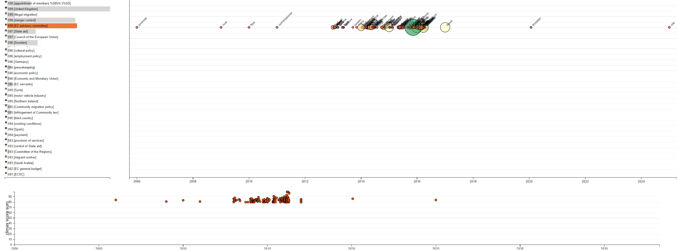
Filter by storyline

Slide 5
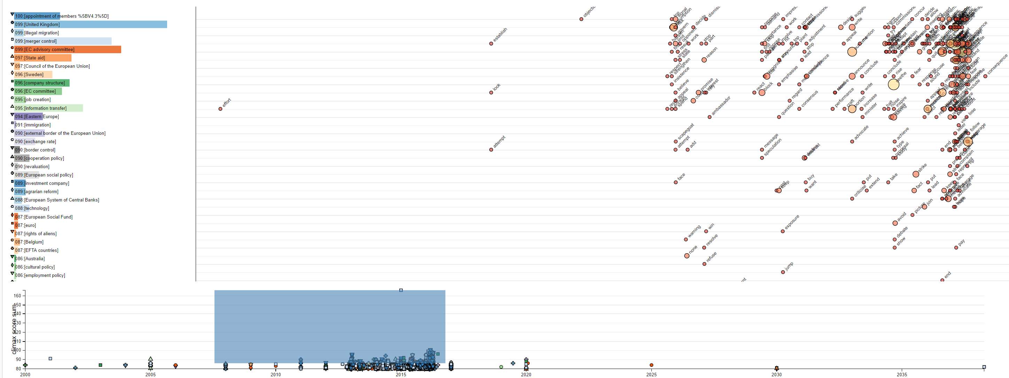
Filter by time / importance

Slide 6
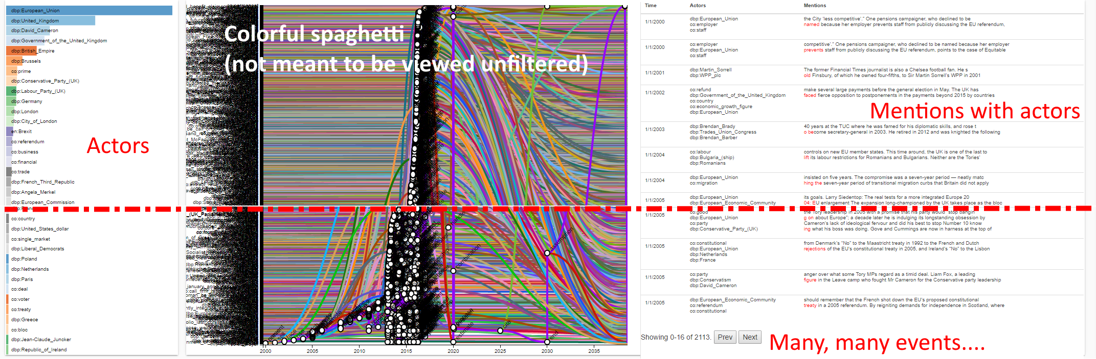
Relations

Slide 7
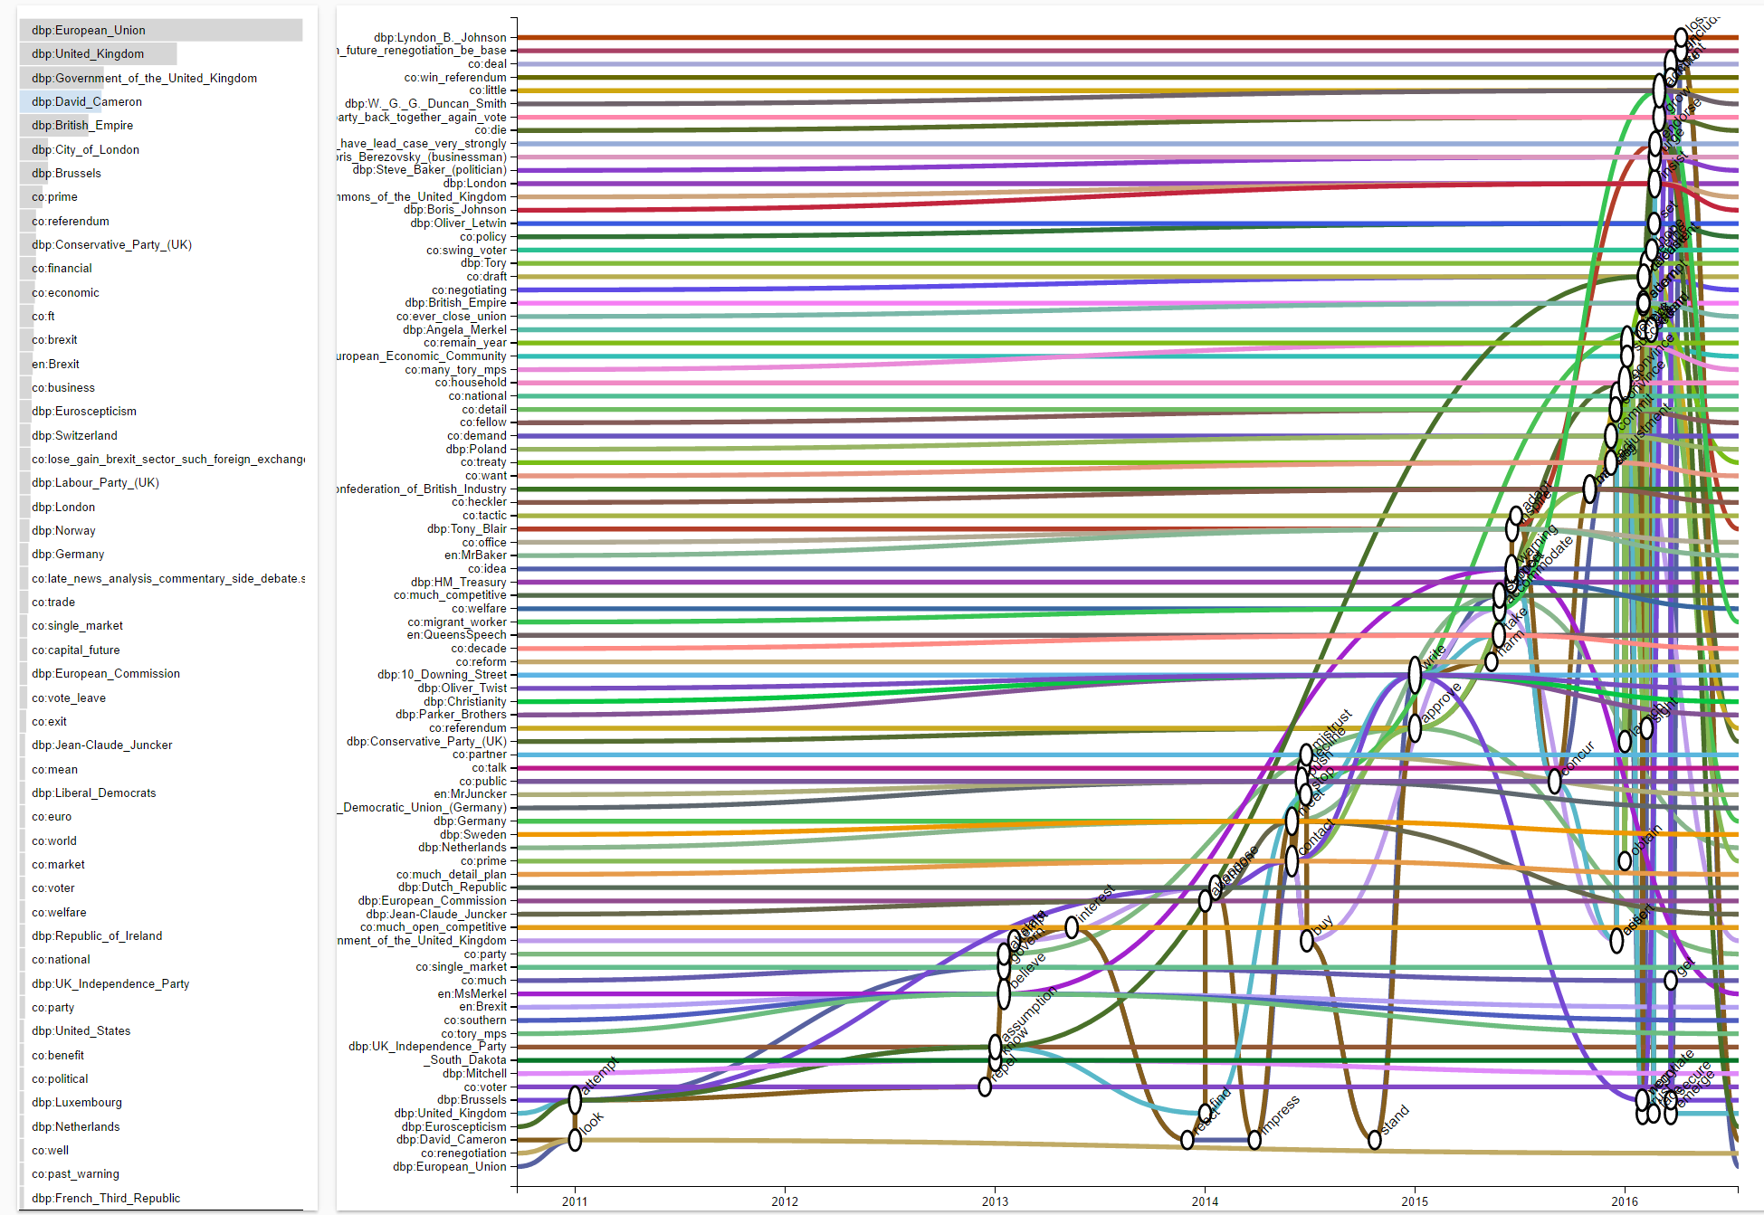
Relations: filtered
David Cameron in the news

Slide 8
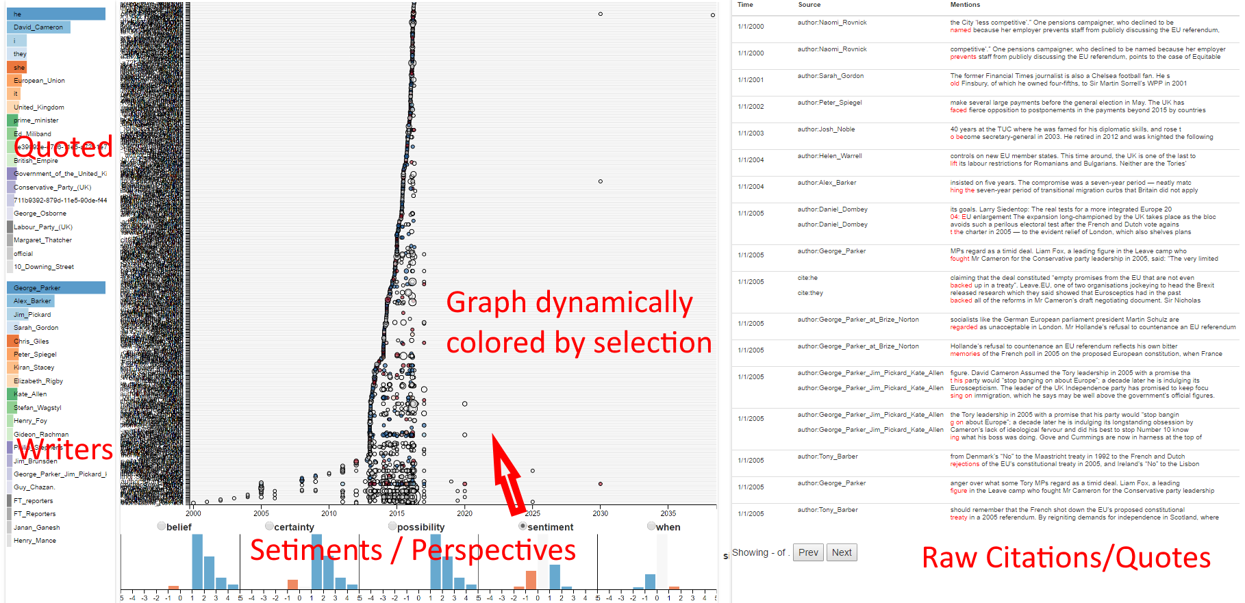
Perspectives

Slide 9
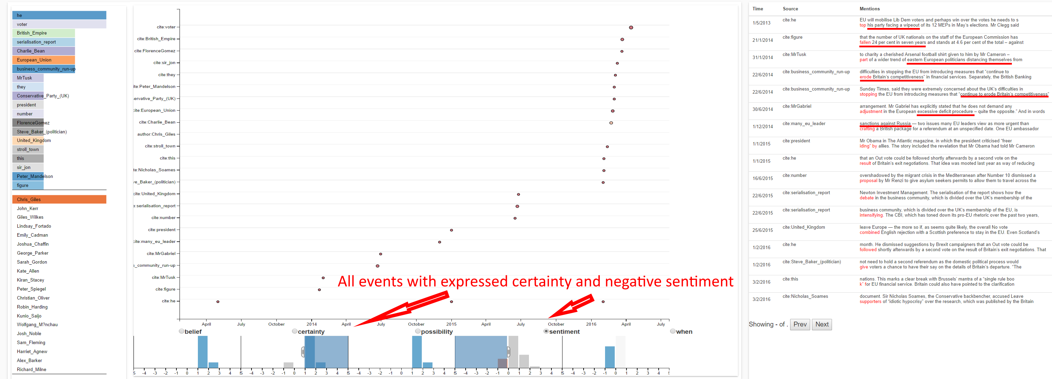
Perspective filters

Slide 10
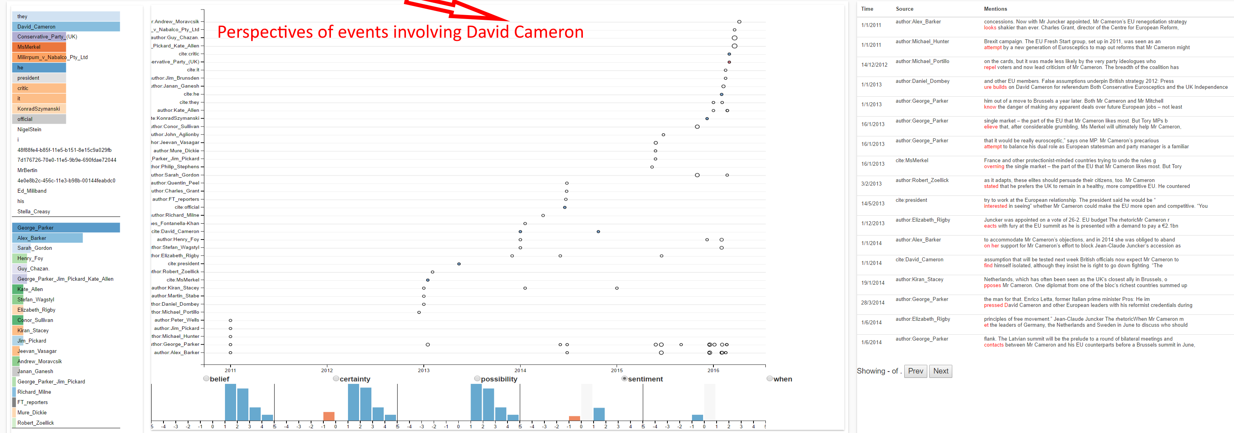
Cross-tab filtering

Slide 11
Visual Information Seeking Mantra
Overview first, zoom and filter, then details-on-demand
Overview first, zoom and filter, then details-on-demand
Overview first, zoom and filter, then details-on-demand
Overview first, zoom and filter, then details-on-demand
Overview first, zoom and filter, then details-on-demand
Overview first, zoom and filter, then details-on-demand
Overview first, zoom and filter, then details-on-demand
Overview first, zoom and filter, then details-on-demand
Overview first, zoom and filter, then details-on-demand
The Eyes Have It: A Task by Data Type Taxonomy for Information Visualizations - Visual Languages, 1996.

Slide 12
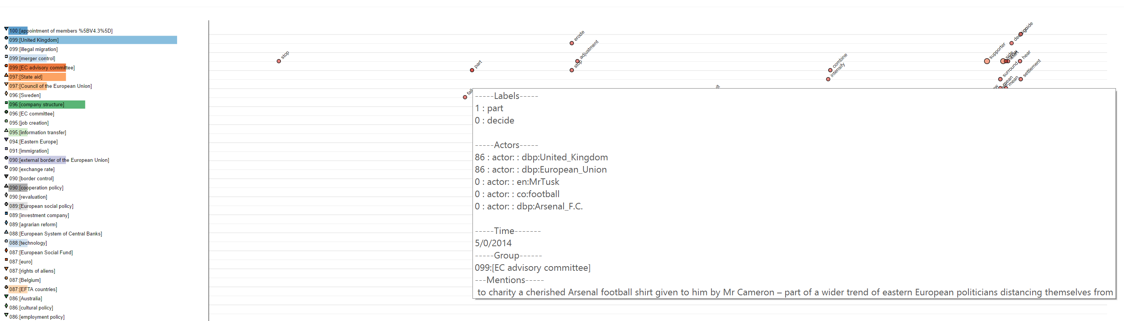
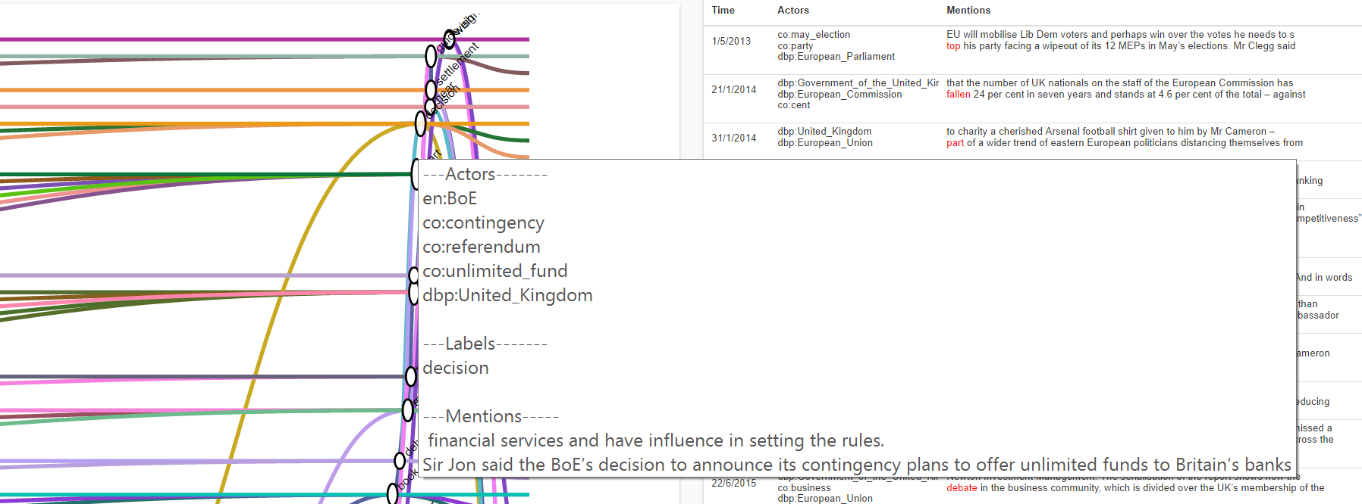
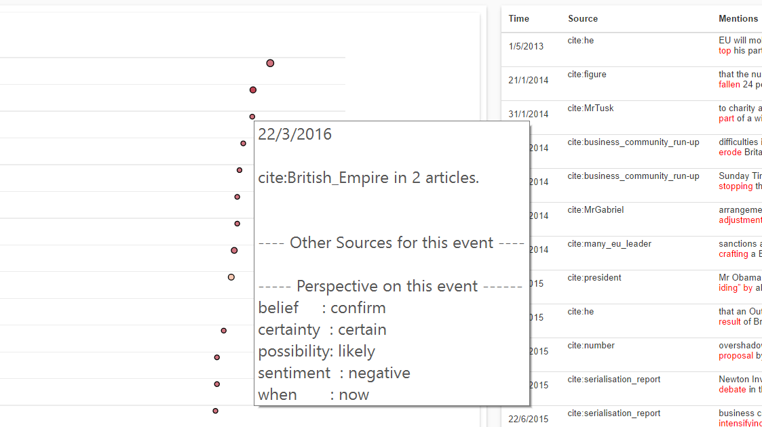
Details-on-demand

Slide 13
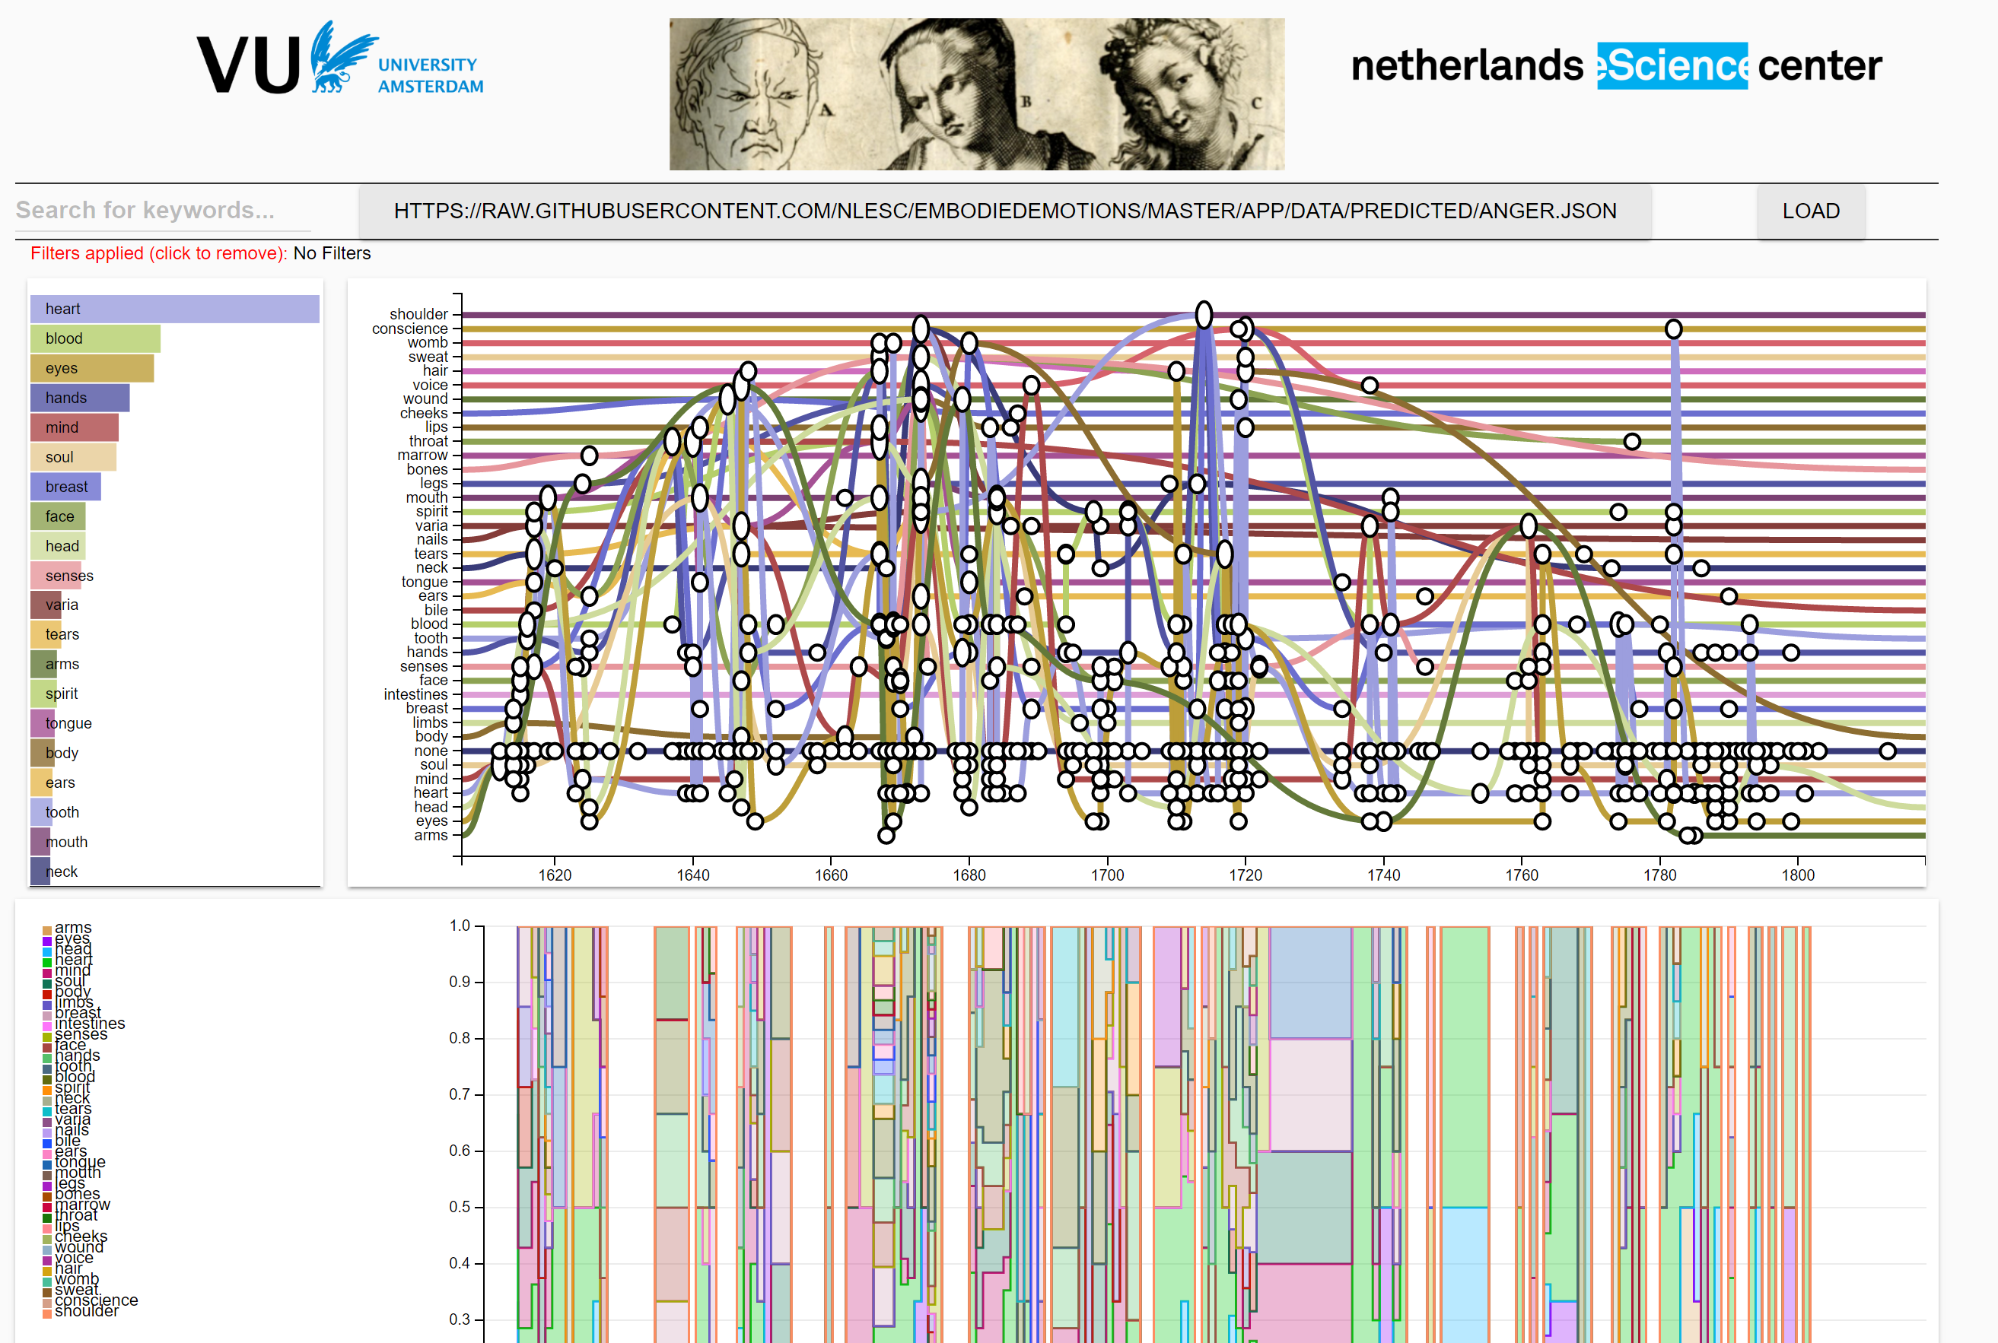
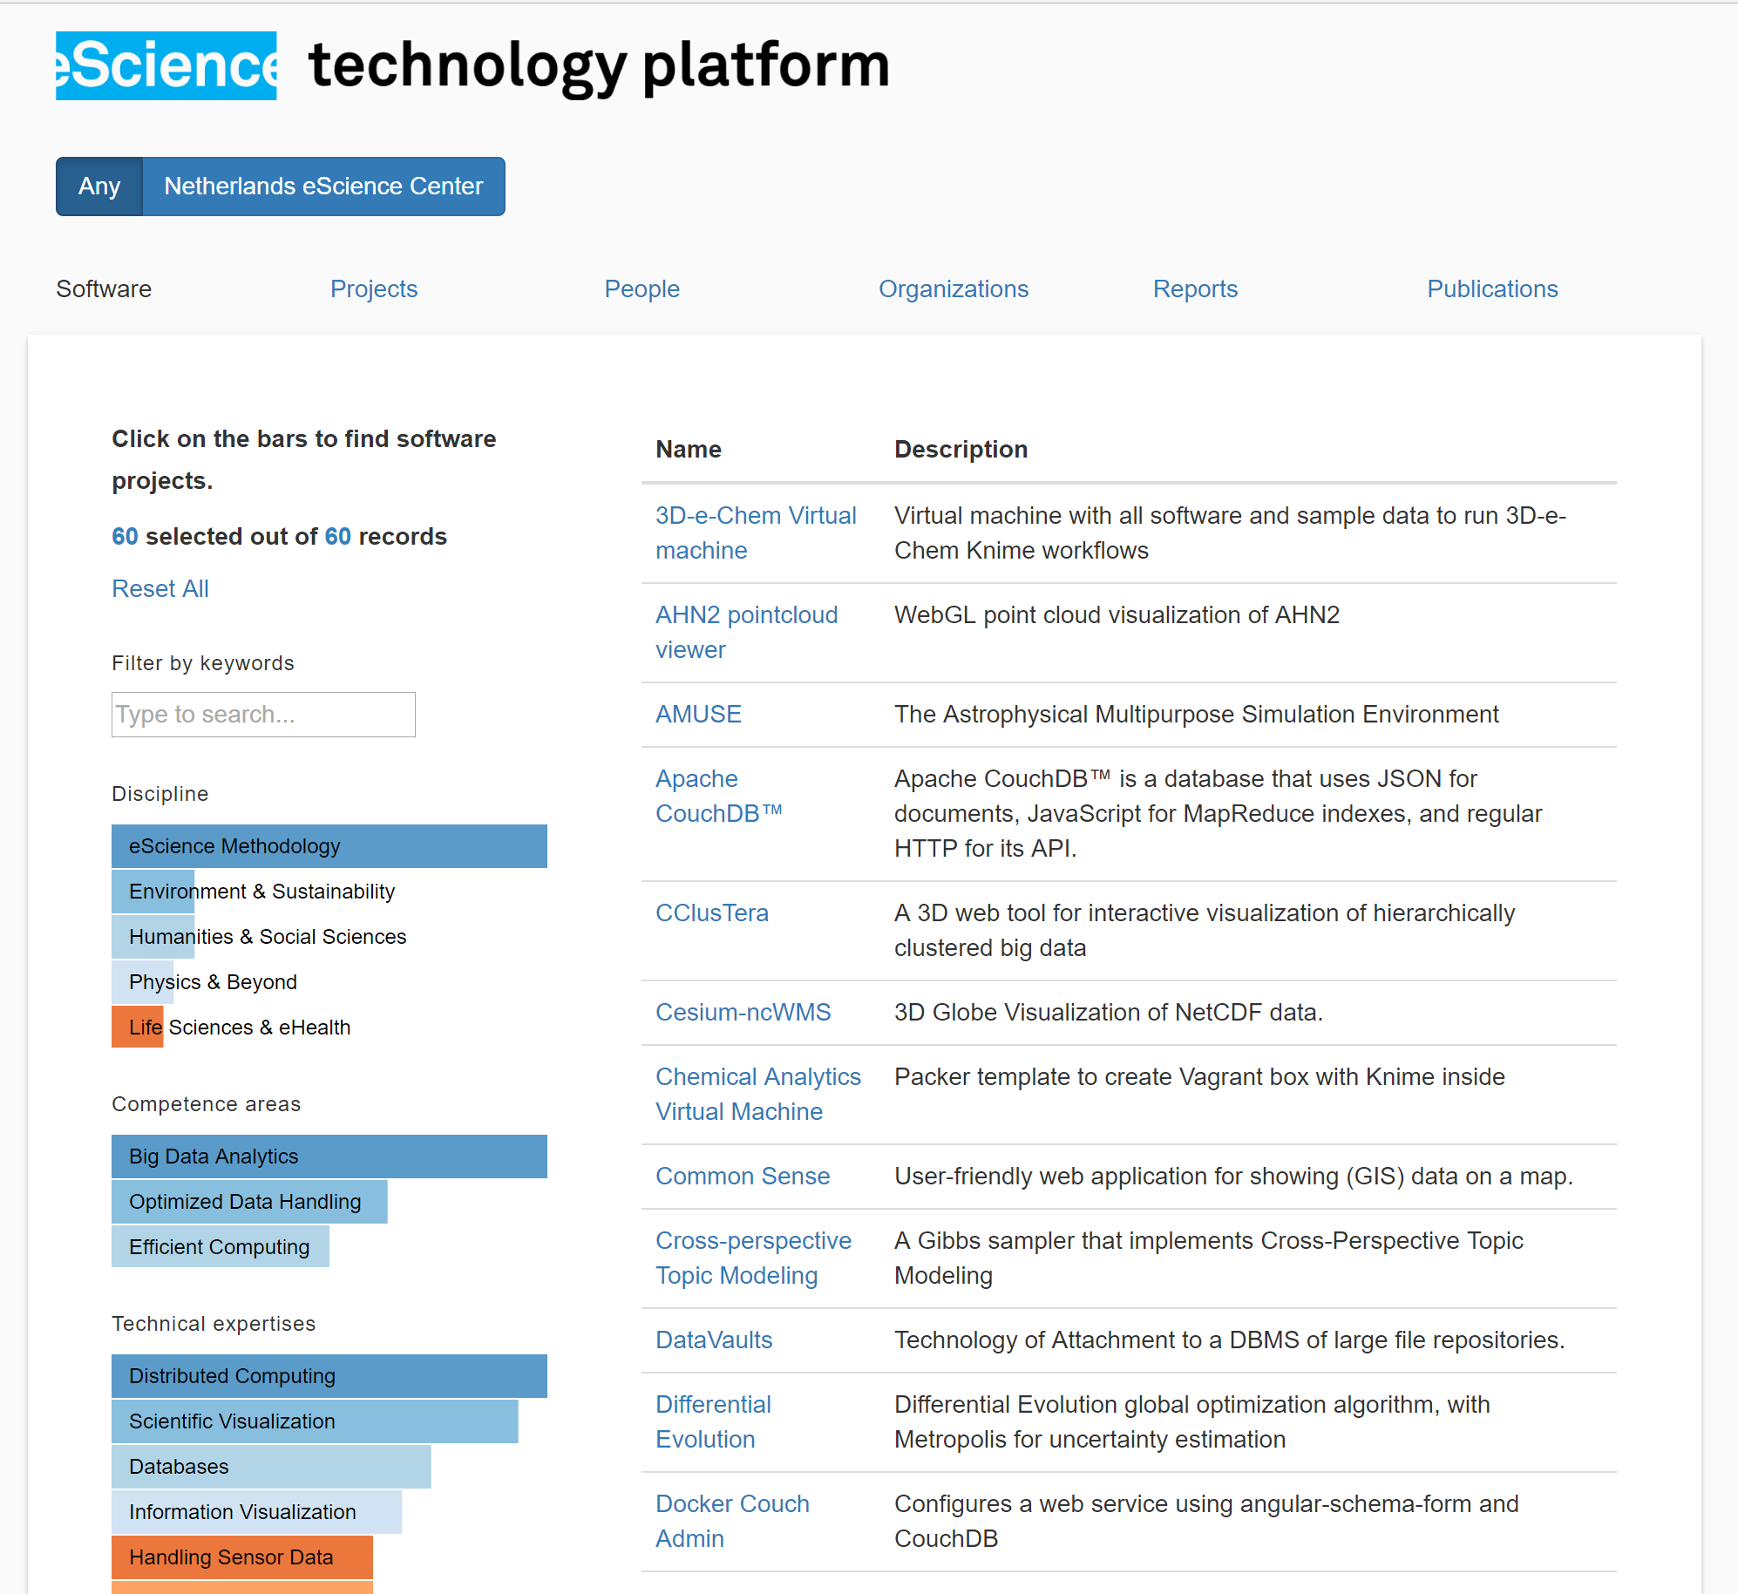
Designed for re-useability

